Slide 1

By Idan Zalzberg
Big Data Tools
Notes:
No changes

Slide 2
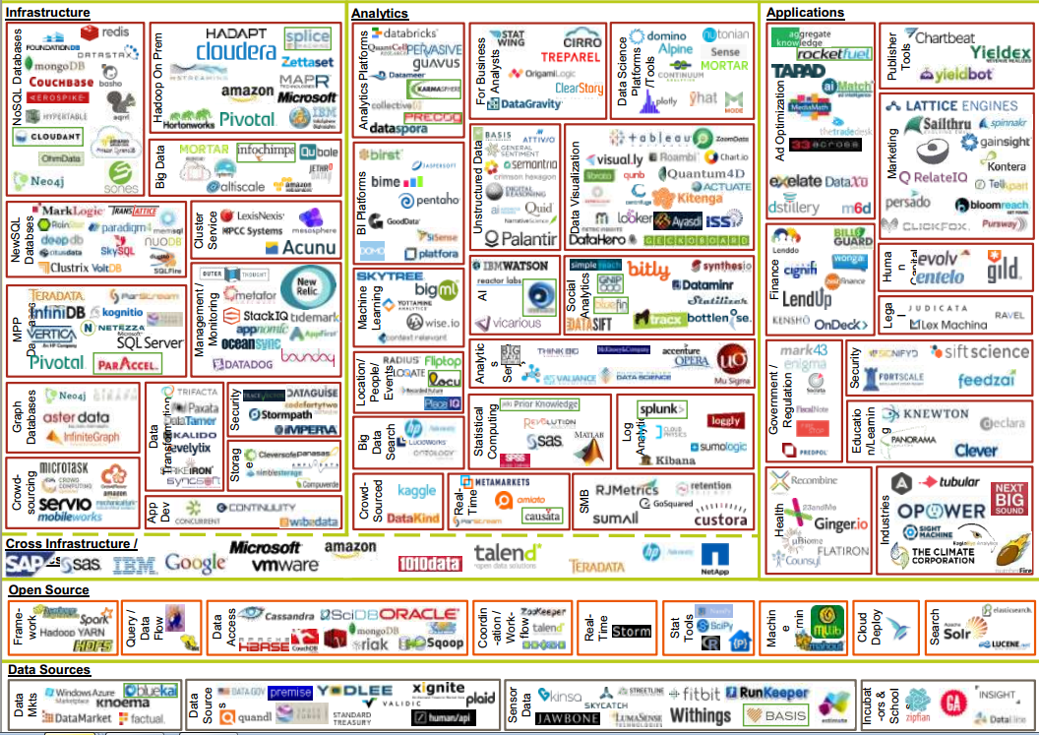
Notes:
Animation (show in order)
1 What’s big data?
2. Subhead – same as data..
3. Body – to be more specific…
So here are the tools, however it might be hard to cover all of them in 10 minutes, instead let’s talk about why we need so many

Slide 3
What’s big data?
Same as data, only much more of it
To be more specific :
Ingesting, Storing, processing and analyzing large* amounts of data
Notes:
Animation (show in order)
1 What’s big data?
2. Subhead – same as data..
3. Body – to be more specific…

Slide 4






“Not Big" data tools
Some data
Notes:
Add animations in order from original slide
Data is inserted into traditional database like sql server or mysql
Data scientists connect from their laptops and query the data
Scientists analyze the data locally with sotware like R and Matlab

Slide 5



What happens with Big data?
TOTAL
FAIL
A lot of data
Big Data requires a completely different architecture
Notes:
Needs to say total fail instead of just x – Something really really broken – basically up in smoke
Replace ”?” with the new ”fail” illustration
Add animations from original slide -
One of the following will happen:
1. Database cannot keep up with the rate of input and crashes
2. Data scientist query huge amount data, crashing the database
3. Network is congested moving the data, it takes forever or fails
4. Local laptop is unable to store all the data
5. Client software does not have enough resources to analyze the data and crashes (or takes years to finish)

Slide 6

Enters – “The Cluster”
“a set of loosely or tightly connected computers that work together so that, in many respects, they can be viewed as a single system”
- Wikipedia
We change the rules of the game:
Data only goes into the cluster, never out
Processing is done where the data is and not vice versa ‘Data locality’
In case we are out of capacity – just add more servers ‘Horizontal scalability’
If one machine fails, another will complete the task – ‘Resiliency’
Sounds great – what’s the catch?
We have to re-write ALL software, everything needs to be
“CLUSTERIFIED”
Notes:
Add image/illustration of cluster (like original slide)

Slide 7























Solving big data one layer at a time
“do one thing and do it well” –Unix Phylosophy
DATABASE
ML LIBRARIES
FRAMEWORK
SCHEDULING
STORAGE
Notes:
Framework needs to be built on top of each other / not “connected” but layered / Cannot give impression that it’s different servers –
Make a cake.
Each layer has many options, the trick is to choose the right stack that is compatible and gives an optimal solution to the challenges
Say a few words about spark

Slide 8
Solving big data one layer at a time
“do one thing and do it well” –Unix Phylosophy
DATABASE
ML LIBRARIES
FRAMEWORK
SCHEDULING
STORAGE
Notes:
Framework needs to be built on top of each other / not “connected” but layered / Cannot give impression that it’s different servers –
Make a cake.
Each layer has many options, the trick is to choose the right stack that is compatible and gives an optimal solution to the challenges
Say a few words about spark

Slide 9

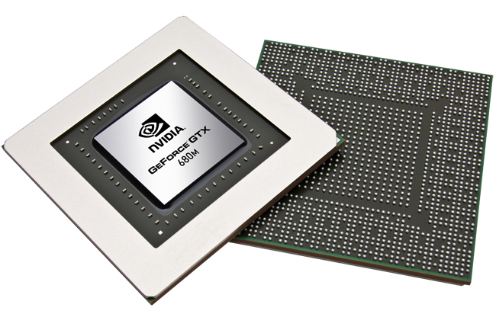
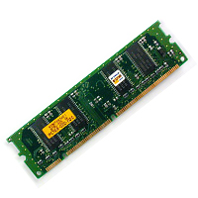
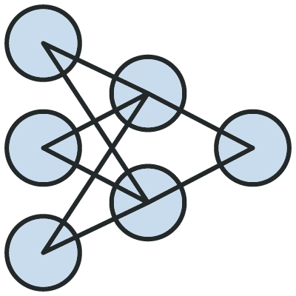
Current trends
Streaming
GPU Processing
In-Memory
Deep Learning
Notes:
No changes
Streaming is the new batch
Streams used to be more difficult but new libraries let developers work with streams as “temporary tables” (spark streaming, flink, beam) and new machine learning frameworks let you do incremental machine learning (tensorflow, h20)
GPU Processing – CPU have been always optimized for generic imperative computation, executing command by command serially. GPU’s have been optimized for parallel computation of specific kinds such matrix multiplication, these are essential for deep learning. For Machine learning, GPU can give a massive improvement if utilized correctly. Since it is less common model for computing, it is also recently that “easy to use” libraries have been created to take advantage of GPU
In Memory
“Memory is the new disk” – This is actually an old statement but only recently became relevant for big-data as well. Spark speed enhancement is primarily gained from working on memory datasets instead of disk and storage engines like Alluxio now offer memory-only storage for big data
Machine learning abstractions
SQL is the undisputed language of data, but there are many languages for machine learning, increasing the learning curve of new employees and creating gaps between departments, there are many efforts today to make a language that is easy to use and still covers all the needs of data science, interestingly SQL is one of them
Technology mashups – while the big companies are fighting on who builds the best database engine, some solutions emerge that are all about utilizing different engines for different issues

Slide 10

The data architect challenge
Big data tools today:
EVOLVE RAPIDLY
&
COSTLY TO CHANGE
Notes:
Animations (show in order)
Big date tools
Change
And
Costly to change
“so what do we do?
I’ll let you know.. Heh heh heh

Slide 11

Thank you
Notes:
No changes

